Slide 1



Smart School
Follow up the educational process
Supervisor Dr. Mohamed Khafagy
Dean Dr. Nabila Mohamed Hassan

Slide 2
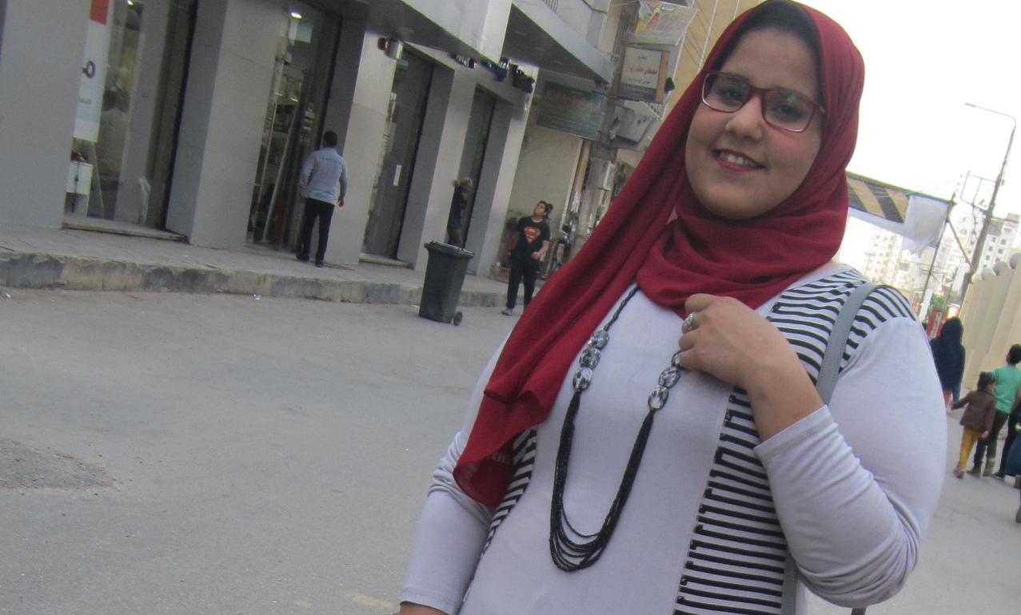
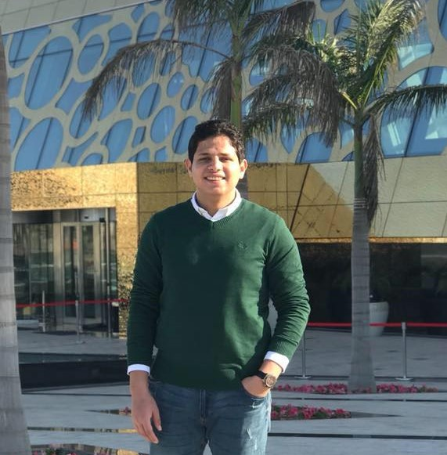
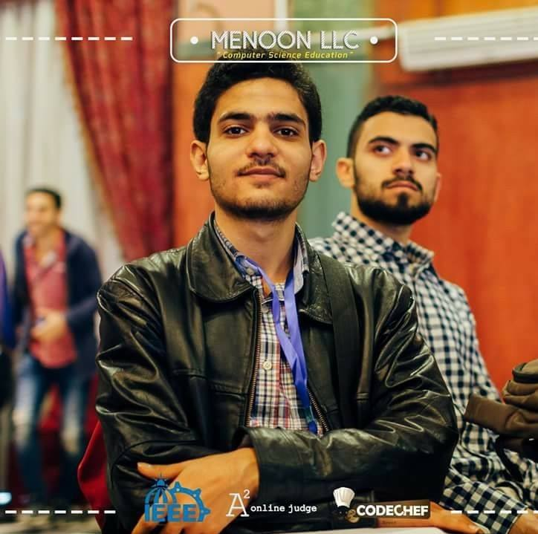

Nilly Hossam
Abdulrahman Mohamed
Adel Ahmed
Hesham Abdel-gawad

Slide 3
TABLE OF CONTENT
6-UI DESIGN
06
Android and Website Demo.
5-IMPLEMENTATION
05
Android & Web Application Techniques.
04
4- Project Plan
Charts and Architecture.
3-CHALLENGES
03
The difficulties in our project.
02
2- TECHNIQUES
Programs and Languages.
1-INTRODUCTION
Problem Definition, Problem Solution and competitors
01

Slide 4

INTRODUCTION

Slide 5
Problem

Slide 6
ABCENCE RATIO IN SCHOOLS 2016:
Primary stage
15%
37%
Preparatory stage
63.5%
Secondary stage

Slide 7
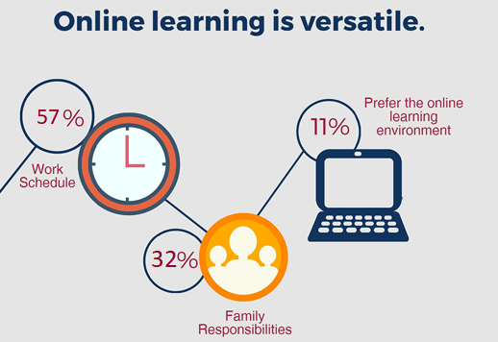
Why smart school?

Slide 8
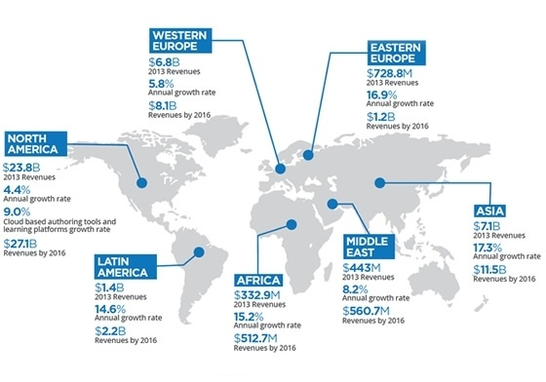
E-learning system analyses 2016(Revenues)

Slide 9
solution
Automated learning system that follow up the educational process
Smart School is an automated system to Follow up the educational process through integration between Teacher, Student and Parent based on web services and mobile .

Slide 10

Currant competitors

Slide 11
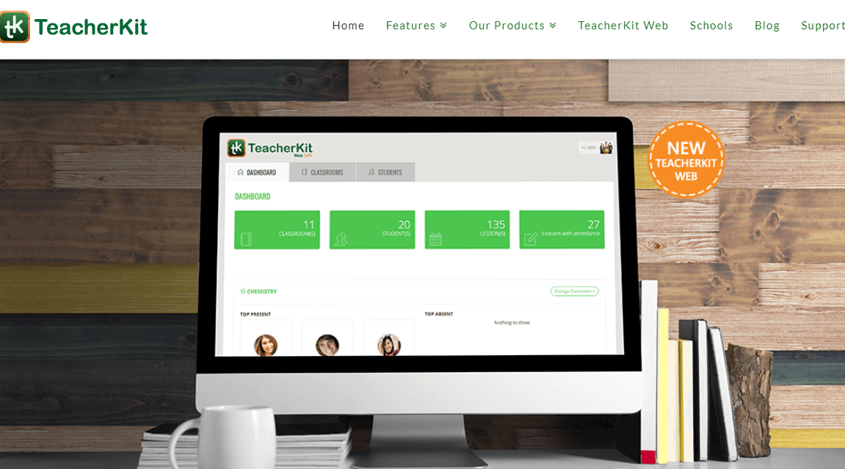
1-TEACHER KIT
Disadvantages:
Support only one language in setup(web)
Advanced features available only in primum trial (Take Attendance!)
No educational videos
No online quizzes.

Slide 12
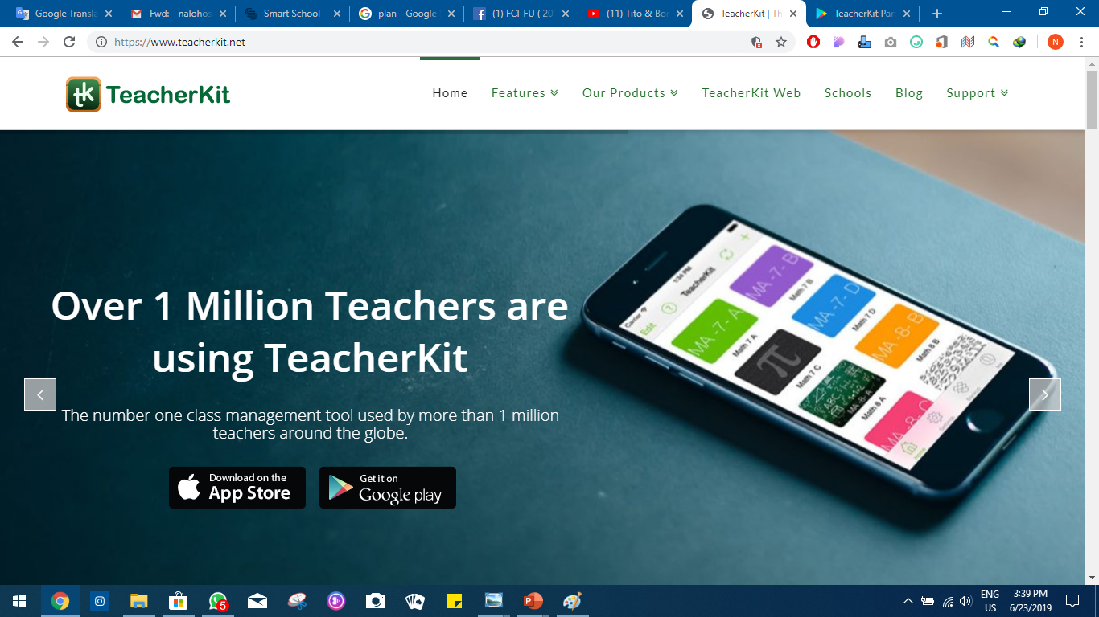
advantages:
Simple UI
secure
Back ups
Dynamic customization.
Cross platform

Slide 13
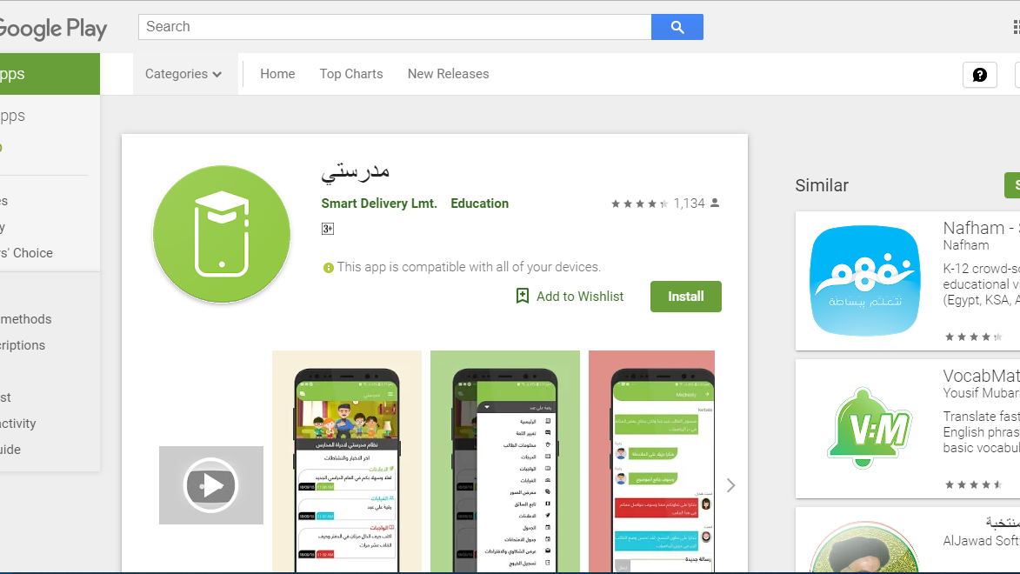
2-مدرستي
Disadvantages:
Not accessible
Sign up
Help
Web application

Slide 14
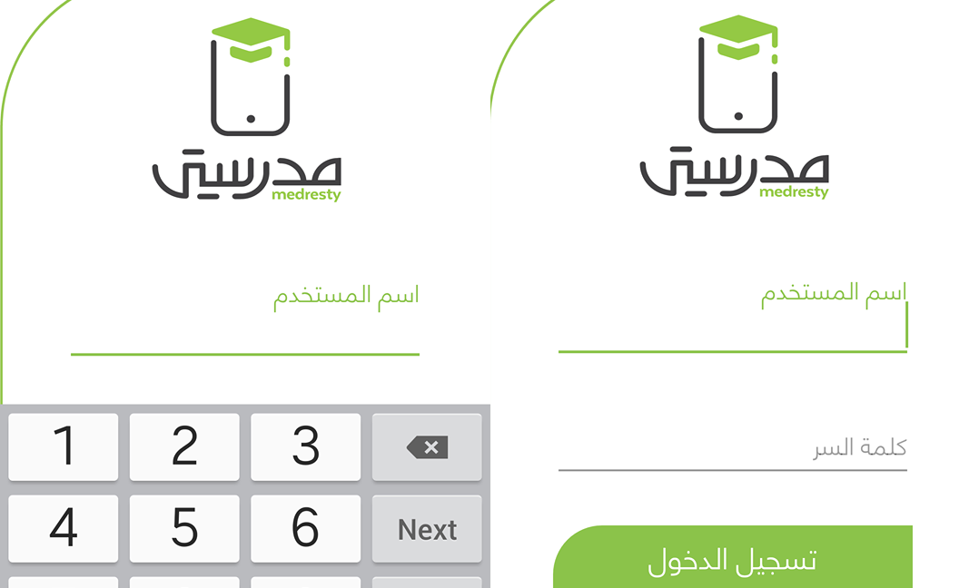
Screenshots of sign up .

Slide 15

Techniques

Slide 16










All techniques that used in android and web application

Slide 17
Challenges

Slide 18
Difficulties that we overcame
Collect required data about school process
1
Permission from the educational administration
2
Study of techniques and technologies required
3
Collect information about teacher and students problems
4
Google maps API (web application)
5

Slide 19

Project Plan

Slide 20
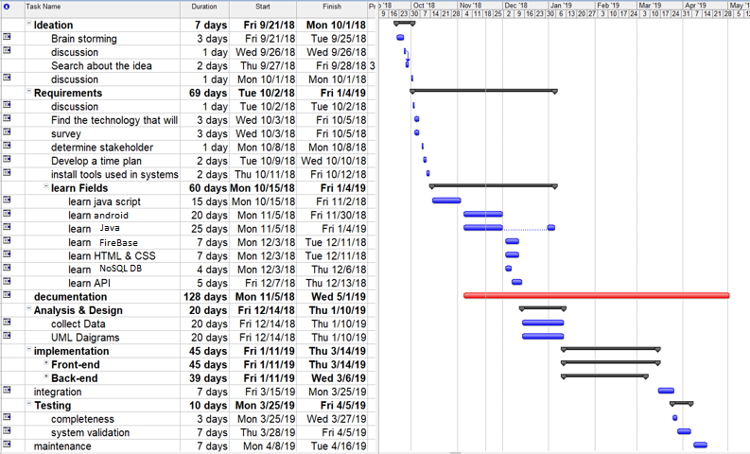

Slide 21
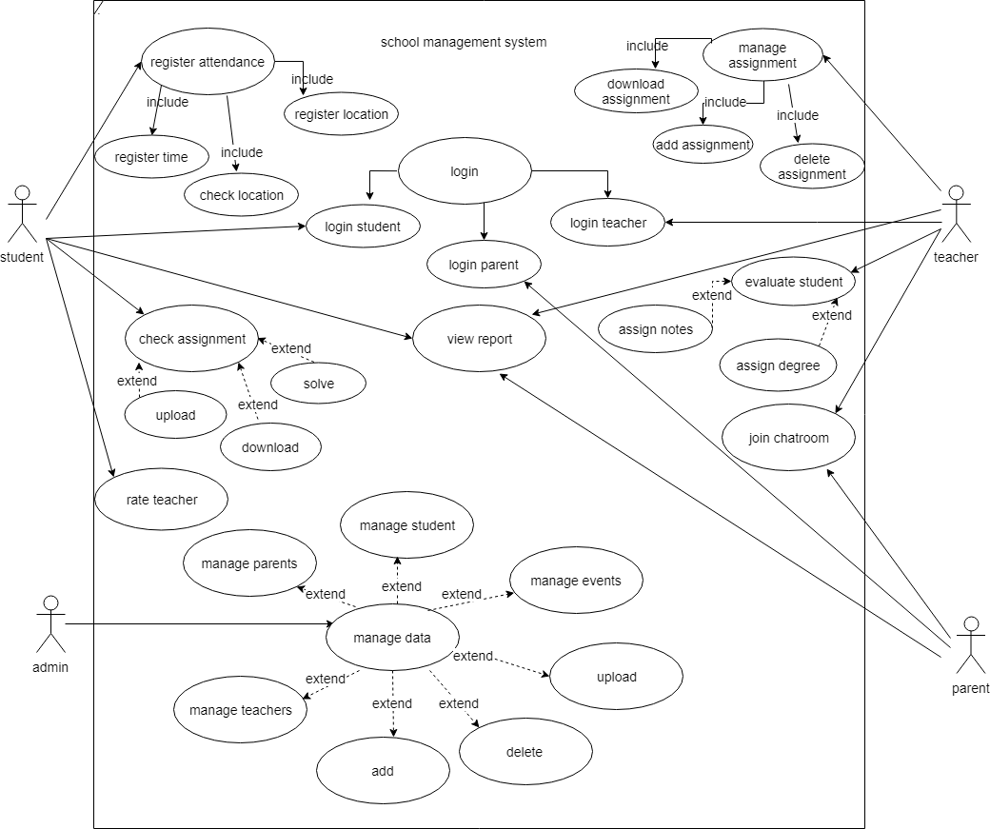
Use case diagram

Slide 22
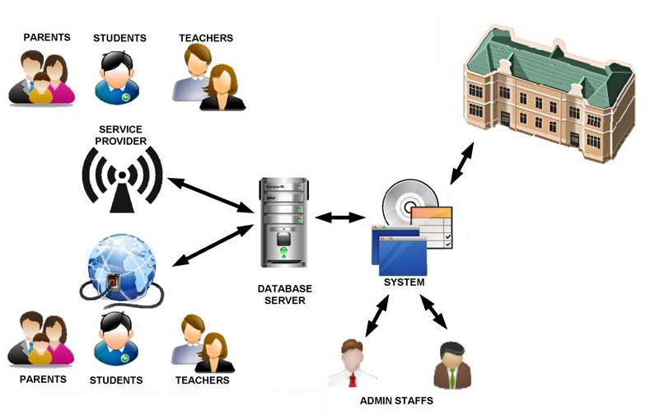
System architecture

Slide 23
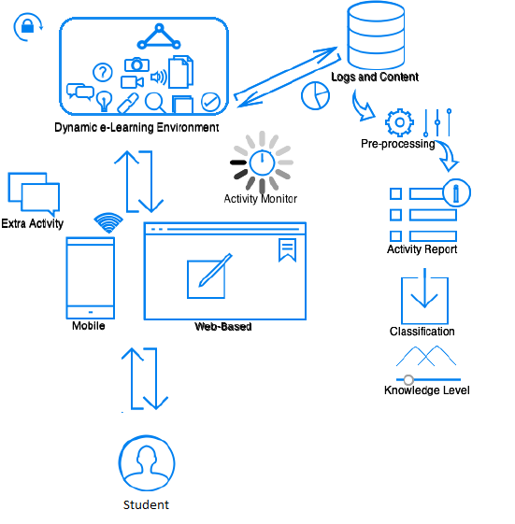
Main user: STUDENT

Slide 24

Implementation

Slide 25




The process of implementation:
4) Testing and maintenance
1) Build firebase DB
The process of implementation:
3)Back-End for web and android apps
2) Design UI for web and android applications

Slide 26


Future Works
01
Online Exams with auto correction.
02
Support multiple language and backups.
03
Face recognition (Login & exams)
04
Bus tracking.
Full monitoring notification.

Slide 27
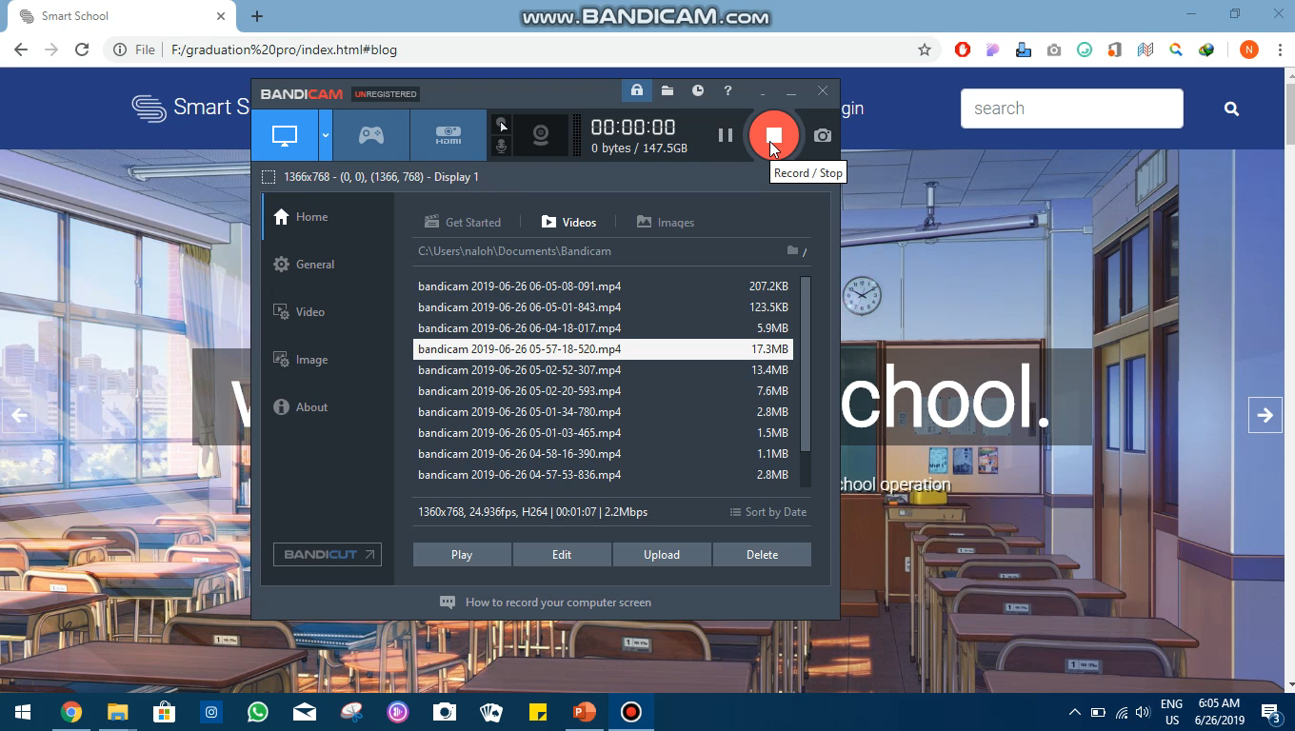
Any user website interface:

Slide 28
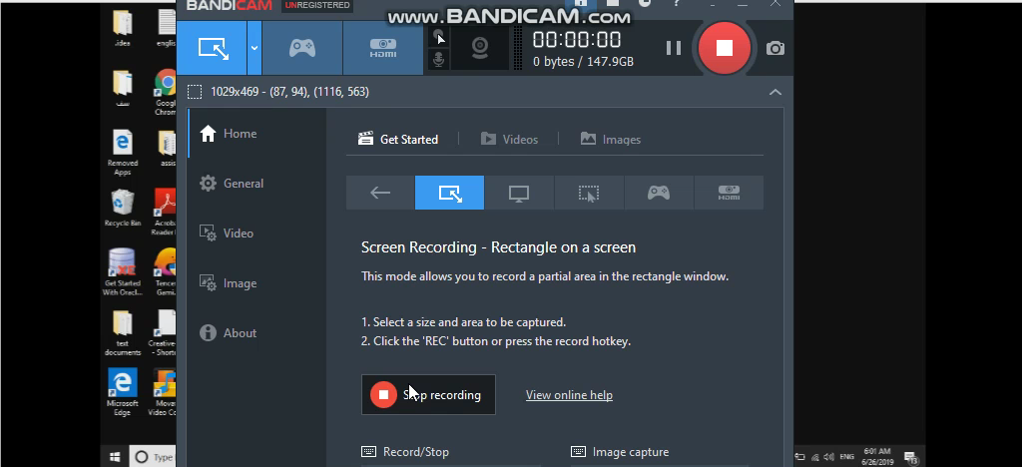
User’s website interface:

Slide 29
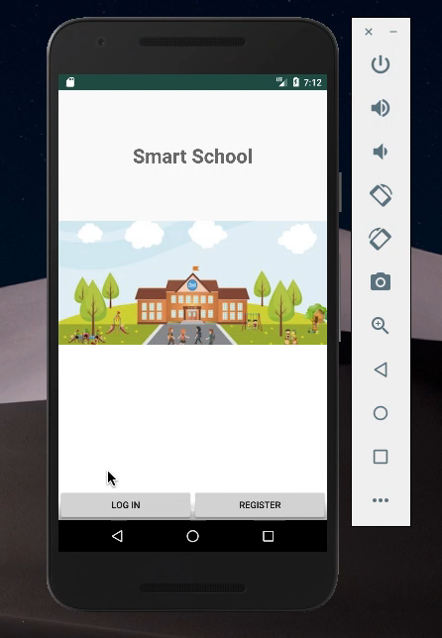
User’s android interface:

Slide 30
THANK YOU!
ANY QUESTIONS?

